Slide 1
Regression Types

Slide 2

Polynomial Regression
Polynomial regression is a type of linear regression where the relationship between the independent variable 𝑥 and the dependent variable 𝑦 is modeled as an 𝑛-degree polynomial.
Instead of a straight line, polynomial regression allows for curved lines to fit complex, non-linear relationships.
Useful for non-linear relationships but requires careful tuning to avoid overfitting.

Slide 3
Pros and Cons
Pros:
Flexibility in capturing non-linear relationships.
Expands linear regression to more complex data patterns.
Cons:
Overfitting is common with high degrees.
Harder to interpret as the degree increases.

Slide 4
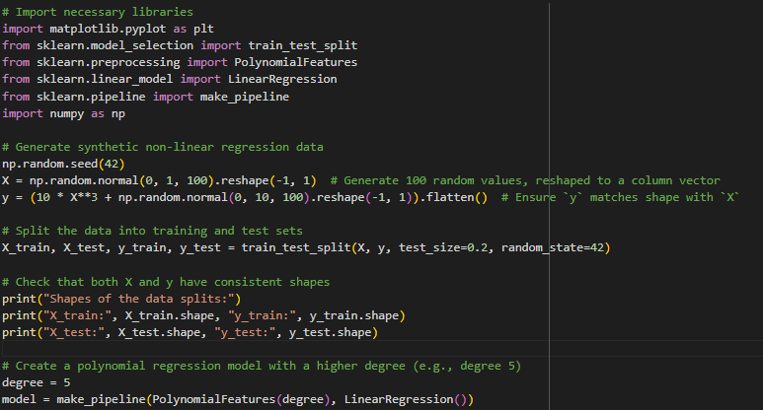
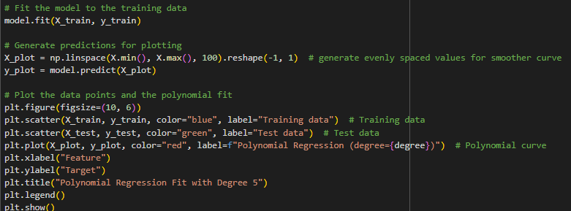

Slide 5
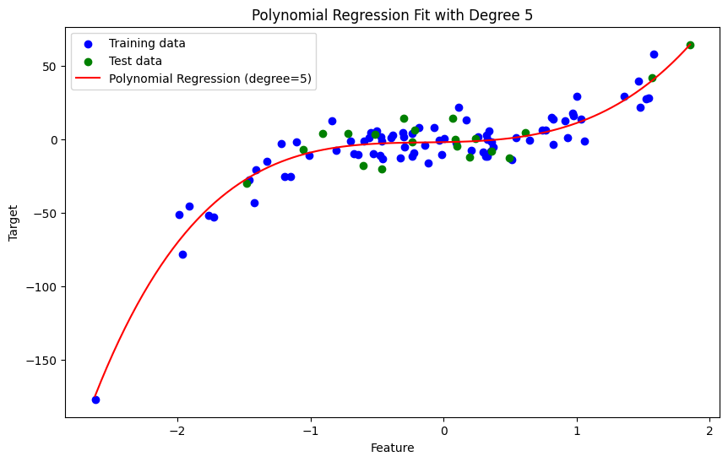

Slide 6

Lasso Regression
Lasso (Least Absolute Shrinkage and Selection Operator) adds an 𝐿1L1-penalty term to the linear regression cost function, shrinking some coefficients to zero and performing feature selection.
The 𝐿1 penalty shrinks less important coefficients to exactly zero, which is effective for feature selection.

Slide 7
Lasso Regression
Lasso can shrink coefficients of less important features all the way to zero, effectively removing them from the model. This means that Lasso performs feature selection automatically, making it particularly useful for high-dimensional datasets where feature selection is challenging.
By adding a regularization penalty, Lasso discourages the model from fitting the training data too closely, thus reducing the risk of overfitting and potentially improving generalization to new data.

Slide 8
Lasso Regression
Like linear regression, Lasso assumes a linear relationship between predictors and the response variable. It does not naturally capture nonlinear relationships unless you add polynomial or interaction terms manually.
Finding the optimal lambda (regularization parameter) can be computationally intensive, often requiring cross-validation or other tuning methods.

Slide 9
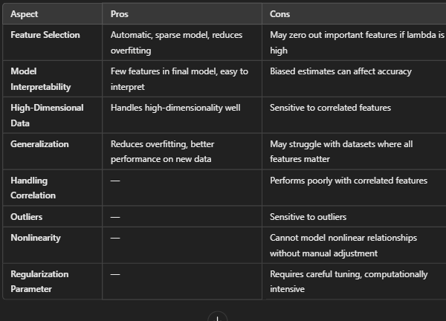
Pros and Cons

Slide 10

Ridge Regression
Ridge regression adds an 𝐿2-penalty, shrinking coefficients toward zero without eliminating them. This can reduce multicollinearity, especially in high-dimensional spaces.
Unlike Lasso, Ridge keeps all coefficients, which can be useful in settings with many relevant features.
The L2-norm encourages all coefficients to shrink proportionally, improving model stability with multicollinearity.

Slide 11
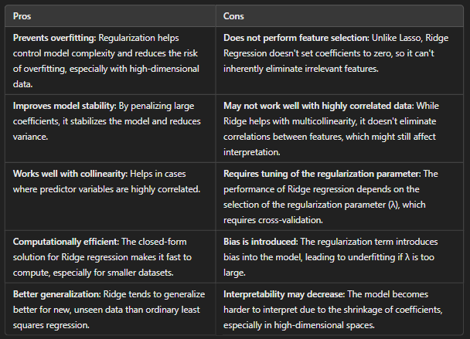
Pros and Cons

Slide 12
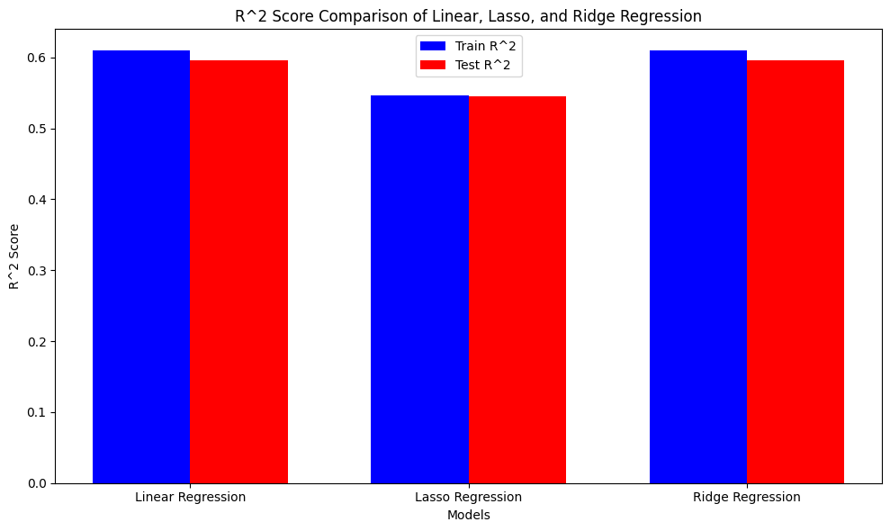
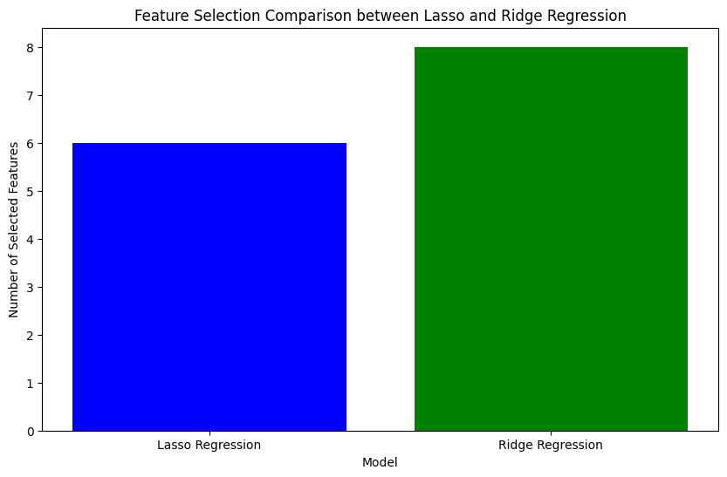
Example
A sample dataset is taken and a jupyter notebook is made that applies linear, lasso and ridge regression on the given dataset. Results are:

Slide 13
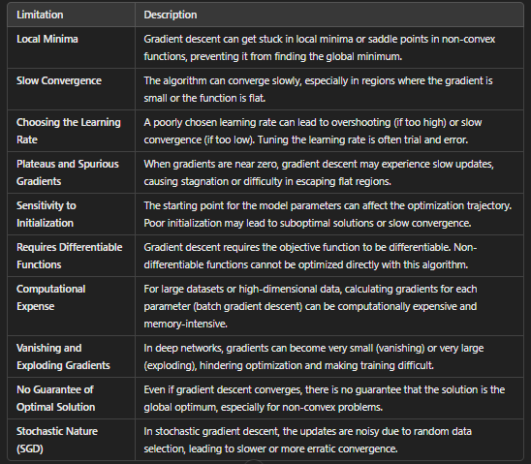
Gradient Descent Limitations

Slide 14
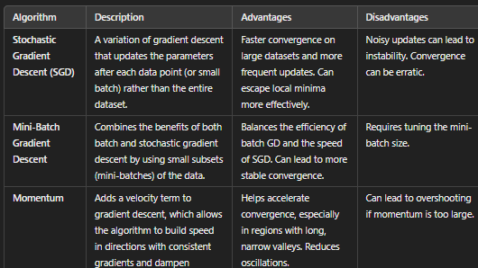
GD Variants

Slide 15
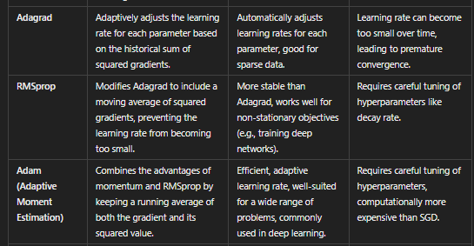
GD Variants

Slide 16

Momentum-based Gradient Descent
Momentum-based gradient descent helps accelerate the convergence by considering past gradients in the current update.
vt​ is the velocity (momentum) at iteration 𝑡
𝛽 is the momentum factor (usually between 0.9 and 0.99)
𝛼 is the learning rate
∇𝜃𝐽(𝜃) is the gradient of the cost function 𝐽(𝜃) at iteration 𝑡
Notes:
Uses exponential weighted average

Slide 17
Pros and Cons
Speeds up convergence, particularly in long, narrow valleys where gradient directions are persistent
Reduces oscillations and helps navigate plateaus
If the momentum term 𝛽 is too large, the algorithm might overshoot the optimal point
Requires tuning the momentum parameter

Slide 18
Example:
Let’s assume:
Learning rate (𝛼) = 0.1
Momentum (𝛽) = 0.9
Initial value of 𝜃 = 2.0
Initial velocity (𝑣0​ ) = 0 (no momentum)

Slide 19
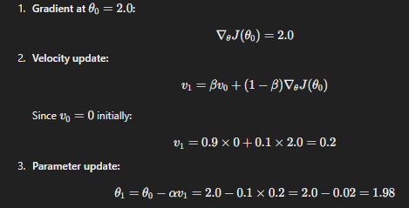
Iteration 1:

Slide 20
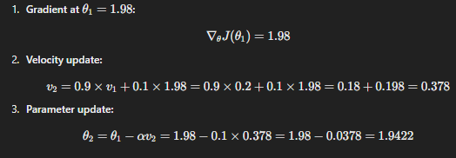
Iteration 2:

Slide 21

Nesterov Accelerated Gradient (NAG)
It’s an improvement over regular momentum, where instead of updating parameters based on the current velocity and then calculating the gradient, it looks ahead by estimating the future position of the parameters
By looking ahead at the updated position of parameters, NAG improves the direction of gradient descent, reducing oscillations and increasing convergence speed
Slightly more computationally expensive due to the need to calculate gradients at the "look-ahead" position
Requires tuning both 𝛽 (momentum) and the learning rate 𝛼

Slide 22


AdaGrad (Adaptive Gradient Algorithm)
It’s an adaptive learning rate method, where the learning rate is adjusted for each parameter based on its past gradients
Parameters that receive large gradients get smaller learning rates, while parameters that receive smaller gradients get larger learning rates
⊙ represents element-wise arithmetic operation

Slide 23
AdaGrad (Pros and Cons)
Automatically adapts the learning rate without requiring manual tuning for each parameter.
The learning rate can decay too quickly, causing the algorithm to stop learning prematurely.
Adagrad’s aggressive decay is often a limitation, especially in problems with non-stationary objectives.

Slide 24


RMSprop(Root Mean Square Propagation)
RMSprop is a modification of Adagrad that addresses its rapid learning rate decay
It uses a moving average of squared gradients instead of the cumulative sum used in Adagrad.
This allows the learning rate to remain more constant over time.

Slide 25
RMSProp (Pros and Cons)
More stable than Adagrad, particularly for non-stationary problems
Works well in deep learning, where the learning rate can fluctuate across different layers
Requires careful tuning of 𝛽 and 𝛼, especially for very noisy data
Sensitive to the learning rate

Slide 26
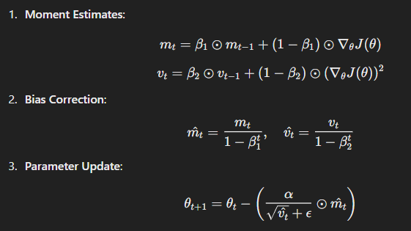
Adam (Adaptive Moment Estimation)
Adam combines the ideas of momentum and RMSprop
It keeps running averages of both the first moment (mean) and the second moment (uncentered variance) of the gradients
The bias-correction terms 𝑚^𝑡​ and 𝑣^𝑡​ help to counteract the initialization bias for the first few steps.
Notes:
Intuition Behind First and Second Moments
First Moment (Mean): Helps track the direction of the gradients. If gradients are consistently pointing in a certain direction (indicating that the function is smooth), the first moment will guide the optimizer to keep moving in that direction. This is like adding momentum to the gradient descent process, which helps to avoid getting stuck in local minima.
Second Moment (Variance): Helps adjust the step size for each parameter based on how noisy the gradient is. If the gradient is large and fluctuates a lot, the second moment controls the updates to be smaller, so as not to make large, unstable steps. On the other hand, if the gradient is small and stable, the second moment allows the optimizer to take larger steps.

Slide 27
Adam (Pros and Cons)
Efficient, computationally cheap, and widely used for deep learning tasks
Well-suited for sparse gradients (e.g., in NLP and computer vision tasks)
Requires less tuning than other optimizers, often performing well out of the box
Computationally more expensive than simple SGD and requires tuning of multiple hyperparameters (𝛼, 𝛽1​ , 𝛽2)
Can overfit if not regularized properly

